Slide 1



Building Wellness for Life
A Multi-Level Capacity Building Approach for High School Health Programming
R01 DK097096
David Lounsbury, PhD
Asst. Professor, Epidemiology & Population Health
Albert Einstein College of Medicine, Bronx, NY
Society for Public Health Education
67th Annual Meeting
Charlotte, NC | The Westin Charlotte
March 30, 2016
Notes:
My name is David Lounsbury. I am a community psychologist with expertise in public health research and systems thinking.
I am part of the research team for this study, which is funded by the National Institute of Diabetes and Digestive and Kidney Diseases.

Slide 2
Building Wellness for
Life Project Overview
National Institute of Diabetes and Digestive and Kidney Diseases
R01 DK097096
Judith Wylie-Rosett, PI
In partnership with HealthCorps and FamilyCook Productions, we are working with a small sample of NYC high schools to:
Introduce, develop and evaluate a participatory implementation model to promote effective wellness programming
Use system thinking to engage school wellness champions in effective action planning
Develop system dynamics models to compliment statistical outcomes modeling and to foster post-project dissemination/scale-up

Slide 3
BWFL Project Research Design
Stepped wedge cluster randomized design
  Year 1: Engage n=2 pilot schools
  Years 2-4: Four new schools per year (N=12 high schools)
  Current sample: N=8 schools in NYC
HealthCorps (HC) Coordinators
  Full-time facilitators placed in HC high schools (one per school)
  Coordinators are trained to implement a standard HC curriculum
  Coordinators facilitate School Wellness Councils (SWCs)
FamilyCook Productions
  Provides expertise in curriculum development
  Pilots student-level tools and assists with evaluation

Slide 4
Project Hypotheses
Students will show improvements in achieving key health behaviors after their NYC HealthCorps school is randomized to the participatory implementation condition (compared to students in the waitlisted HealthCorps control schools)
Improvements in the key health behaviors will be greater in students whose BMI z-scores decrease compare to those whose BMI z-scores do not decrease

Slide 5
Key Health Behaviors
Promote achievement of goals of the Healthy, Hunger-Free Kids Act and the U.S. Dietary Guidelines:
Increasing frequency of breakfast
Increasing vegetable and fruit intake (2½ cups/day)
Decreasing sugary beverage intake | Increasing water consumption
Decreasing frequency of fast food meals
Becoming physically active (1 hour/ day) | Reducing sedentary behavior time (<2 hour/day)

Slide 6
School Wellness Councils
Serve as mediating structures for our participatory research
Are coalitions of diverse stakeholders: Students, educators, administrators, parents, and CBOs
Operate at the school building or campus level and function in an advisory role to principals
Key objective: Systematically identify and address school building/campus-specific wellness goals
NYC DOE, 2010

Slide 7
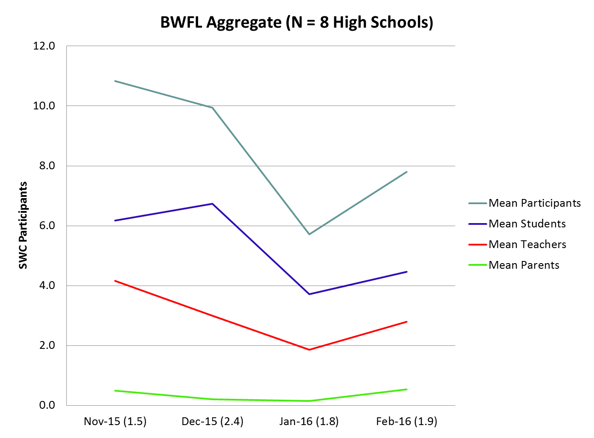

Slide 8
BWFL Objective: Help School Wellness Councils Thrive
Systems Thinking: To ‘see’ novel ways to achieve local wellness priorities
Student Assessment: To engage students via a brief electronic health survey to identify their biggest health behavior challenges
SMART Action Planning: To select and adapt activities that support implementing wellness priorities (at both the school and individual level)
Evaluating Change: Use system dynamics modeling to synthesize available information about processes and outcomes of implementation efforts
Specific | Measureable | Actionable | Reasonable | Time-bound
Notes:
Specific | Measureable | Actionable | Reasonable | Time-bound
SMART Goals and can help foster student-level behavioral skill-building as well as school-level program capacity

Slide 9
1. Systems Thinking: Use Systems Models to ‘See’ Objectives and Goals
Through BWFL Year 1 pilot work, three intervention themes emerged:
Support healthy choices and behaviors (diet and exercise) via skill-building wellness programs
Build collaborative capacity for planning and sustainability of school wellness
Grow community support to expand resources for school wellness programming
These themes are illustrated in a complex causal loop diagram (CLD), designed in a way that is consistent with the system dynamics modeling methodology.
Notes:
Causal Loop Diagrams are used to qualitatively depict feedback dynamics

Slide 10
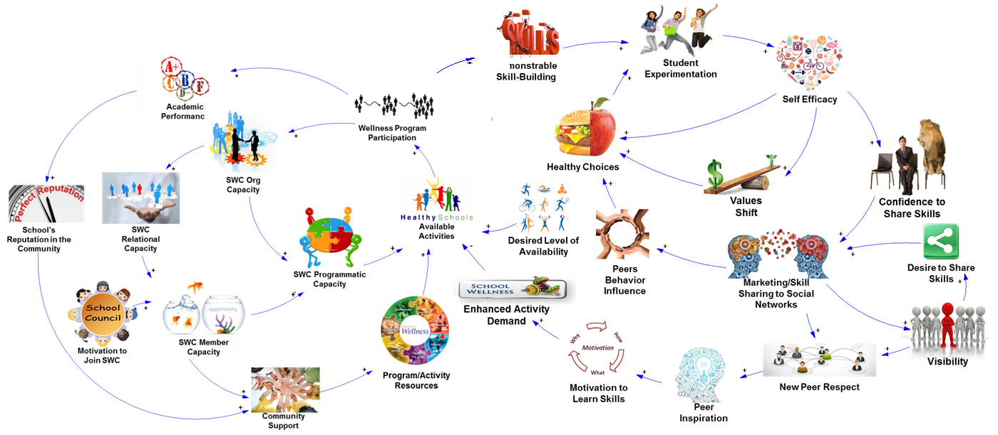
Animated CLD of Effective Wellness Program Implementation
FamilyCookProductions.com
School Level
School Level
Demonstrable
Skill-building
Student Level
Student Level
Foster-Fishman et al. (2001)
Notes:
In the Better Wellness for Life introduction, we showed how systems thinking helps us understand how make positive changes at two levels, at the level of the school and among individual students. Both are important, and, as we can see, progress at either level is interdependent. When your school launches a new, skill-based wellness activity for students, that cycles back to support development and encourage participation in your School Wellness Council. So, let’s focus on making positive change at the school level.

Slide 11


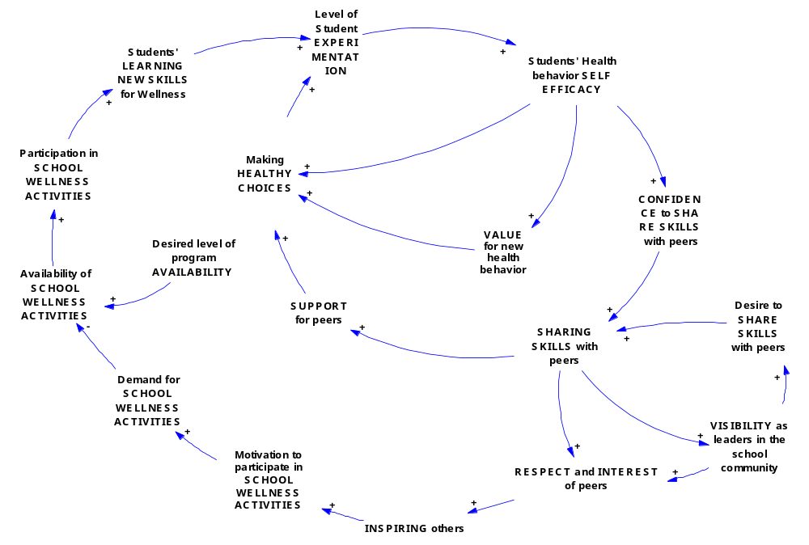
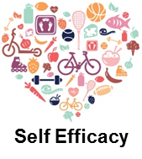
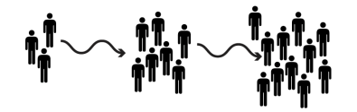










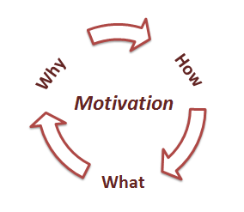


Demonstrable Skill-Building
Participation in Activities
Healthy Choices
Values Shift
Available Activities
Desired Level of Availability
Peers Behavior Influence
Desire to Share Skills
Enhanced Activity Demand
Visibility
Motivation to
Learn Skills
New Peer Respect
Peer Inspiration
Student Level

Slide 12

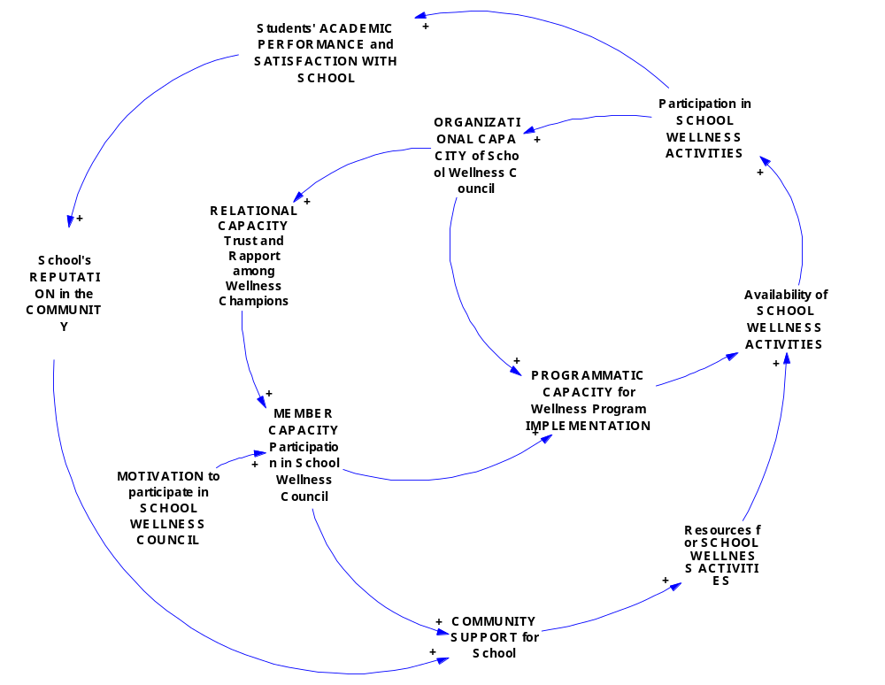
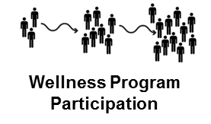





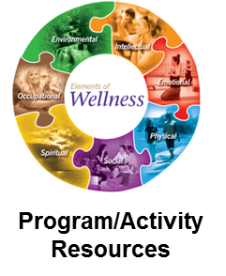

School Level
School’s Reputation in the Community
Available Activities
+
SWC Programmatic Capacity
+
Collaborative Capacity

Slide 13
Collaborative Capacity
Relational capacity: Trust, respect, and strong rapport among wellness champions
Member capacity: Skills and knowledge that help wellness champions work together
Organizational capacity: Ability to support, design, and carry out SMART action plans
Programmatic capacity: Implementing and sustaining a new wellness programs or policies that foster student skill-building
Foster-Fishman et al. (2001)

Slide 14
2. Student Assessment: Feedback Reporting on Biggest Health Behavior Challenges
BWFL “Healthy-Me-Meter”
  Student-level (individual) feedback report (PDF delivered via e-mail)
  School-level (aggregate) feedback report presented to School Wellness Council and other school leaders
Data source: A self-reported survey of students’ key health behaviors and related psychosocial attitudes and barriers about exercise and healthy eating
Consistent with Audit and Feedback (A&F) approaches to organizational change (Audet et al., 2005; Davis et al., 2006; Ivers et al., 2014)
Notes:
We have identified a variety of useful data sources and reports, and summarized key information into a single report

Slide 15
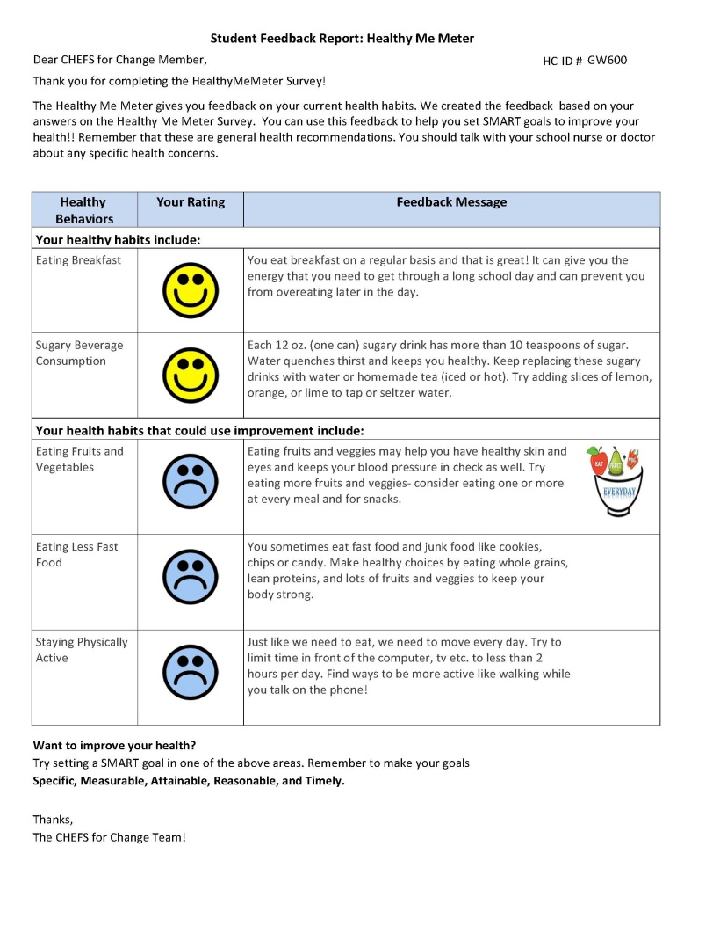
Sample student “Healthy-Me- Meter” feedback report:

Slide 16
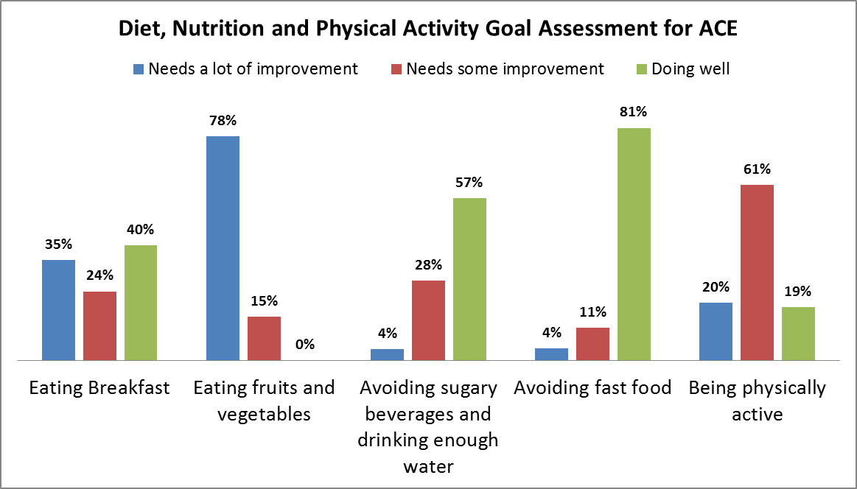
Sample aggregate “Healthy-Me-Meter” feedback report:
xxx
Overall, students do well avoiding fast foods, sugary beverages and drinking enough water.
Students should try eating more fruits and veggies- consider eating one or more at every meal and for snacks.
Score range: 0-100
0 – 33 Needs a lot of improvement
34 – 66 Needs some improvement
67 to 100 Doing great!

Slide 17
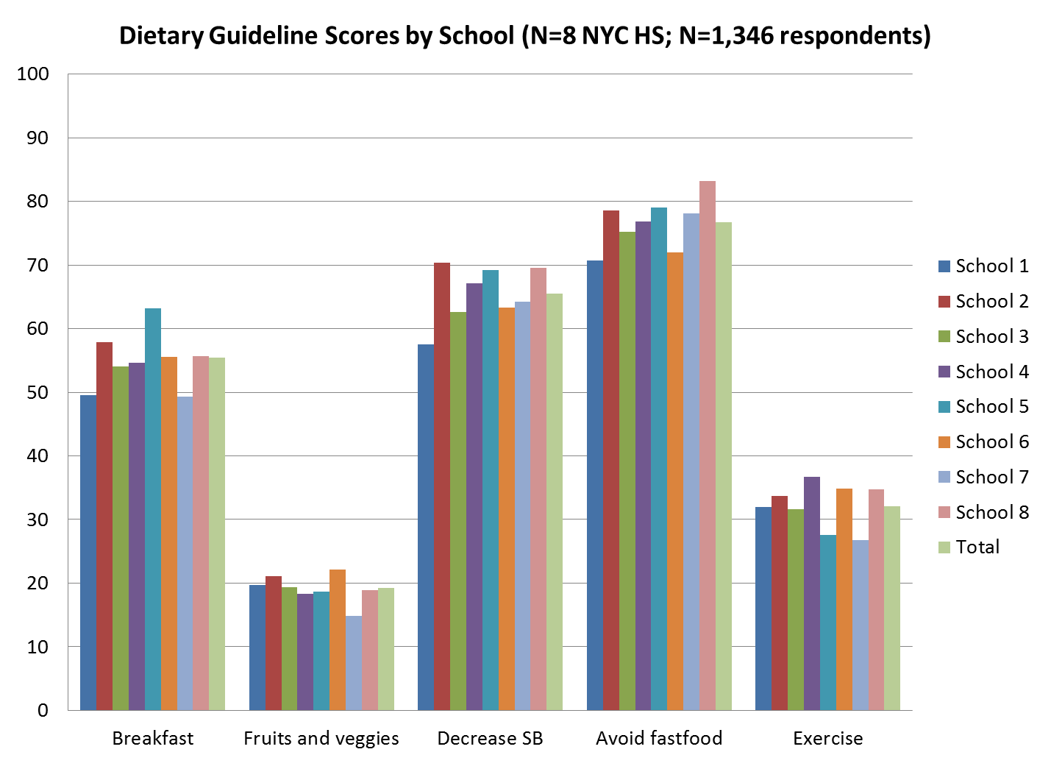
HMM
Avg.
Score
Score range: 0-100
0 – 33 Needs a lot of improvement
34 – 66 Needs some improvement
67 to 100 Doing great!

Slide 18
3. SMART Action Planning: Select and Adapt Resources from Our Toolkit
BWFL curriculum resources:
School level
Principal Engagement Letter
DOE Guide to Community School Health Councils
Building and Sustaining School Wellness: Systems Model
SWC SMART Goal Action Planning Guide
Student level
Healthy-Me-Meter instrument and reports with SMART Action Planning Facilitation Guide
Student’s SMART Action Planning Reinforcement Guide
Yoga Share Facilitation Guide
Make One Share One Facilitation Guide

Slide 19
4. Evaluating Change: Assess processes and outcomes of implementation efforts
BWFL evaluation tools:
Healthy-Me-Meter Survey (on-line portal)
Monthly Wellness Council Activity Report (on-line portal)
Key Informant and Focus Group Guide (mid-way and end-of-year)
Apply RE-AIM (Glasgow, 2008):
  Who is/is not reached? Reach
  How will these actions/activities make a difference? For whom? Effectiveness
  What are the biggest barriers/facilitators to implementing these actions/activities? Adoption | Implementation
  What the biggest barriers/facilitators to sustaining these actions/activities? Maintenance

Slide 20
System Dynamics Modeling as a Complimentary Evaluation Method
System dynamics (SD) modeling is a computer-aided approach to policy design and analysis
Our cluster randomized design will enable multi-level statistical modeling, however:
  Low statistical power is concern (Type II Error)
  Quality of data (reliability) is of concern
SD modeling builds upon statistical findings and enhances understanding of the intervention
  Synthesizes information from multiple data sources
  Shows causal structures and high leverage parameters that drive wellness program outcomes in complex environments

Slide 21
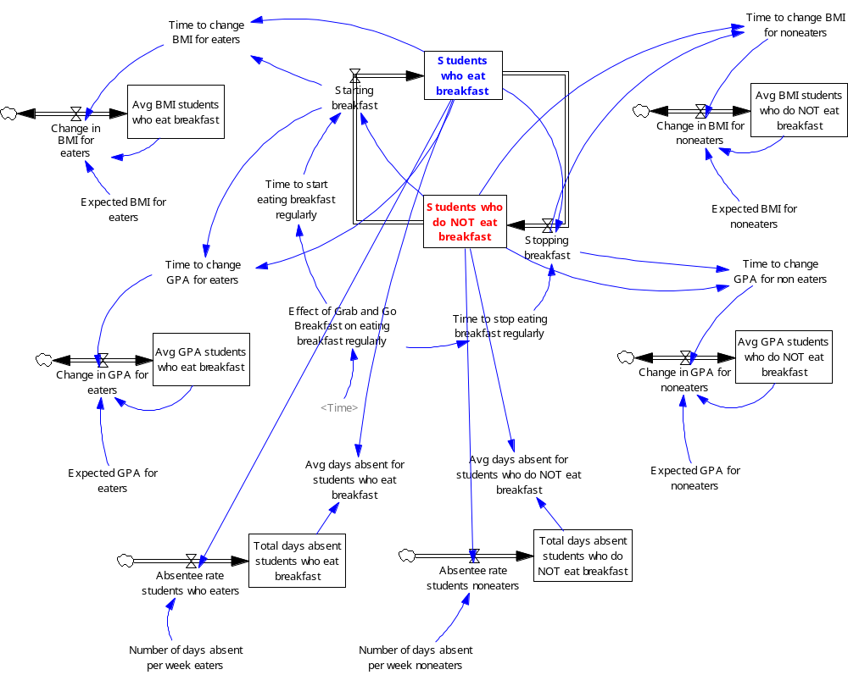
Demo SD Model 1: “Grab and Go Breakfast”

Slide 22
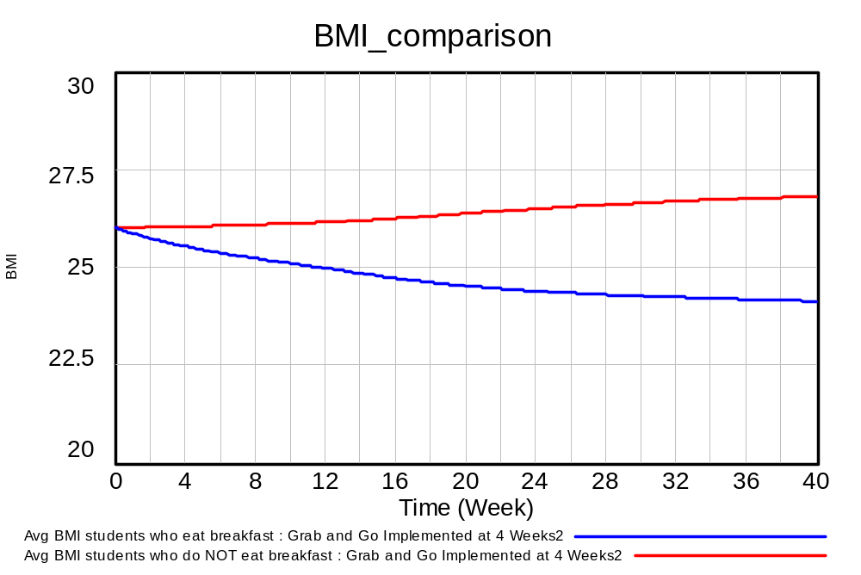

Slide 23
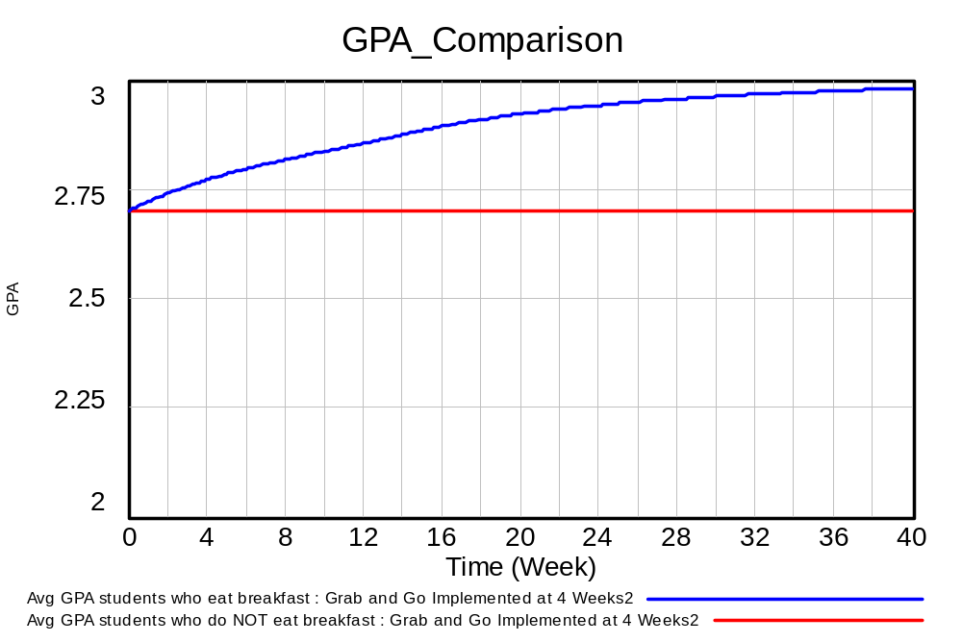

Slide 24
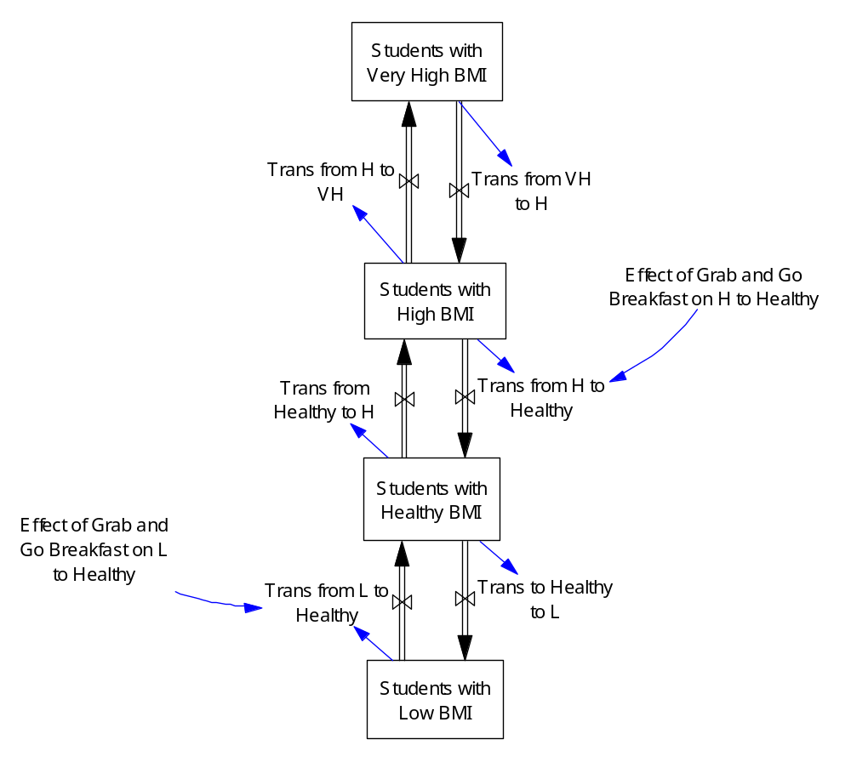
Demo SD Model 2: “Grab and Go Breakfast”

Slide 25
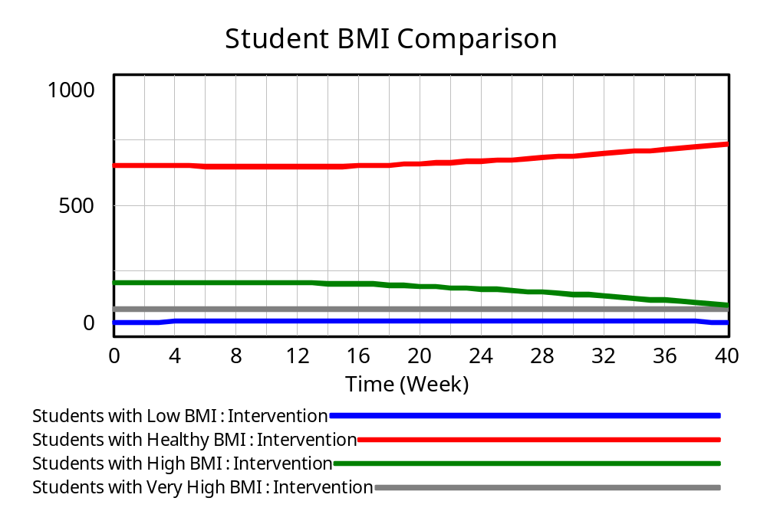

Slide 26
Conclusions
BWFL project seeks to learn how to better support schools in the design, implementation, and evaluation of school wellness initiatives
Systems thinking/SD modeling approach fosters critical thinking among school wellness stakeholders:
  Embraces complexity of change processes at two levels: student and school
  Quality of participatory process has varied greatly across schools
BWFL approach is promising, but full results are forthcoming and are based on small sample of schools:
  Final year is reserved for dissemination piloting, which will be key to assessing the utility of our approach

Slide 27
Acknowledgements
Albert Einstein College of Medicine
  David Lounsbury, Judith Wylie-Rosett, Camille Gonzalez, Mindy Ginsberg, Arthur E. Blank, Moon- Seong Heo, Natania W. Ostrovsky, and Carmen R. Isasi (Co-Investigators)
FamilyCook Productions
  Lynn Fredericks and staff (Program Developers)
HealthCorps
  Emily Zagnit, Jean Lim and HealthCorps Coordinators (Implementers)
NYC DOE Office of School Wellness
  Kristen O'Brien and Jennifer Paulino (Program Liaisons)
Michigan State University
  Ralph Levine (Consulting Investigator)

Slide 28
THANK YOU!
David Lounsbury, PhD
Albert Einstein College of Medicine
Dept. of Epidemiology and Population Health
Bronx, New York
David.Lounsbury@einstein.yu.edu
917.690.1020

